Slide 1
TechShoppers – System Architecture Presentation of Group 03
Group Members:
1905003 – Sheikh Intiser Uddin Dipta
1905014 – Tanhiat Fatema Afnan
1905030 – Nazmus Sakib Sami

Slide 2
Choice of an Architecture
We will use the Model-View-Controller (MVC) architecture to design and develop this application.
Components of MVC
Model - Represents the application data and business logic
View - User interface which displays the model data
Controller - Mediates input/output between the model and view

Slide 3
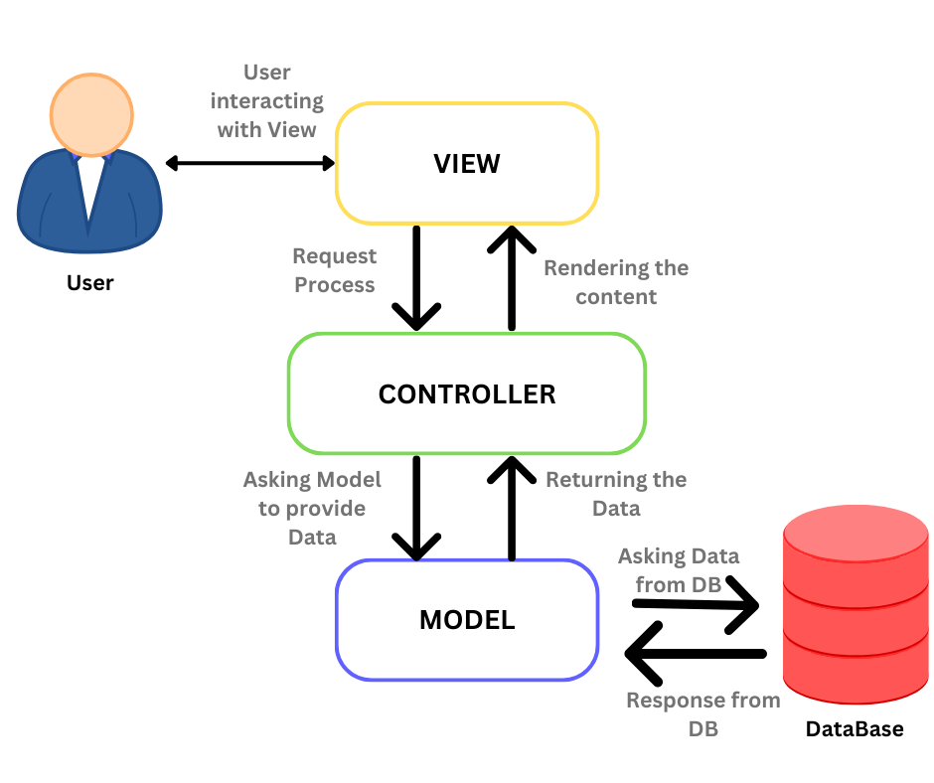
Data and Control Flow of MVC

Slide 4
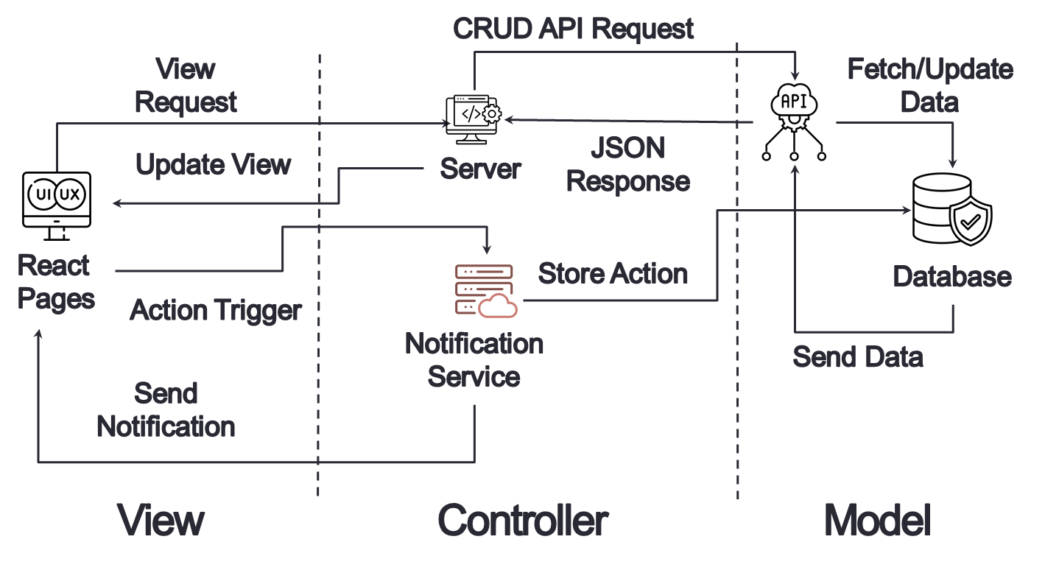
MVC in TechShoppers

Slide 5
Motivation for Choosing MVC
Separates application's data layer from presentation layer
Promotes loose coupling between components
Allows easy maintenance and scaling of the application
Supports separation of concerns and single responsibility principle

Slide 6
Model Details
Database models and Schema for products, prices, websites etc.
Services to fetch data from retailers' APIs
Contains business logic to retrieve and manipulate data
Database: MongoDB with Mongoose

Slide 7
View Details
User interface components - HTML, CSS, JavaScript
Displays model data to the user.
Gets data from and passes data to the controller.
Framework: React
Aspects of the Controller can also be implemented by using React hooks like useState, useEffect, and useContext to handle user interactions, send requests to backend controllers, and manage the application state.

Slide 8
Controller Details
Mediates between model and view
Gets data from model and passes to view and vice versa
Updates model data if needed
Framework: Express.js
Handle HTTP requests from frontend (Axios or fetch API)
Use Express.js to define route handlers (controllers) that interact with the Mongoose model to fetch or modify data and then send responses/views (JSON data, status codes) back to the client.

Slide 9


Slide 10

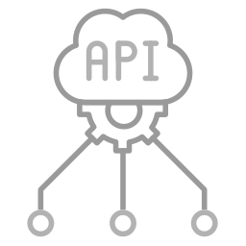


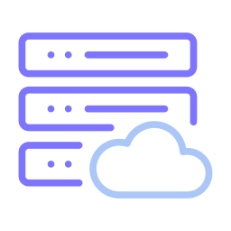
Spare Slide – Modify the Diagram Here if Needed and then Copy at Appropriate Slide
CRUD API Request
View Request
Fetch/Update Data
Update View
JSON Response
Server
React
Pages
Store Action
Database
Action Trigger
Notification Service
Send Data
Send Notification
View
Controller
Model

